Slide 1
Chapter 9_3 Sound in medicine
Dr rafid albadr |

Slide 2
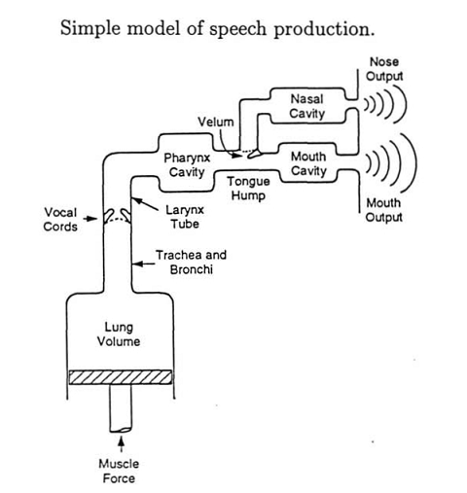
The protection of the speech

Slide 3
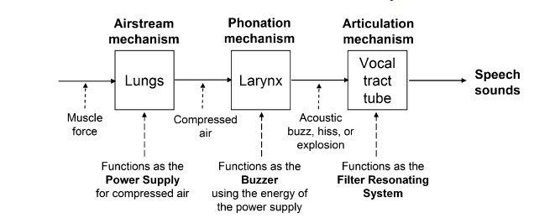
The protection of the speech

Slide 4
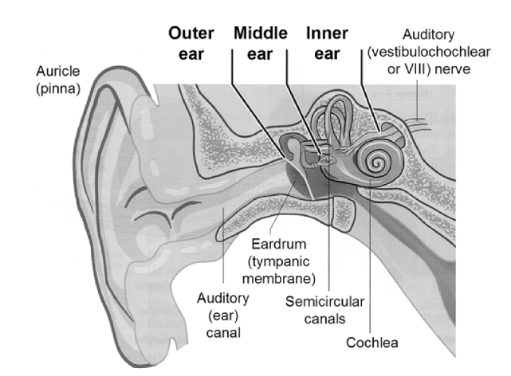
The physics of ear

Slide 5
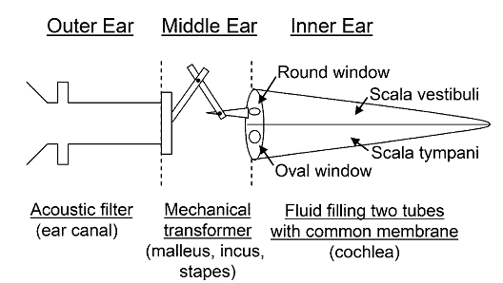
The physics of ear

Slide 6
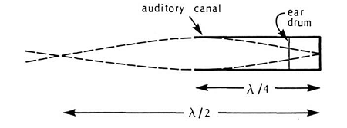
The physics of ear
OUTER EAR

Slide 7
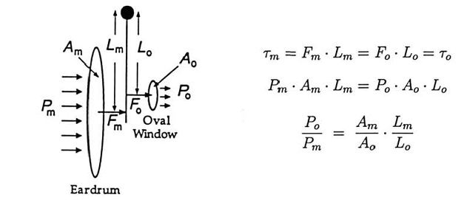
The physics of ear
MIDDLE EAR

Slide 8
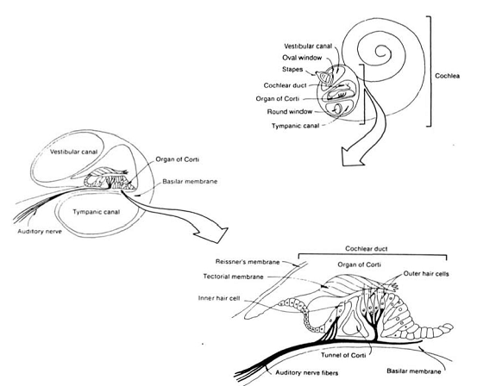
The physics of ear
INNER EAR

Slide 9
determine the thickness of tissue needed to decrease the intensity of a 5 MHz ultrasound wave by half. (Assume losses are due only to absorption, and not due to reflection at interfaces.)
The speeds of sound in the brain and skull bone are 1,550 and 4,090 m/s, respectively. What fraction of sound is lost in reflection from air to the skull bone and then from the skull bone to the brain? Assume the densities of the brain and skull bone are 1 g/cm3

